Slide 1
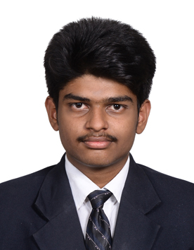
Srivasthan R GE Oil & Gas SSO - 212616647
“True Innovation is coming up with the product that the customer didn’t even know they need it“
ABOUT ME
Student – PSG College of Technology
PATENTS Filed:
Electronic Sound Control systems in industries
Automatic Equal Length cutting machine
AWARDS: 1. National Level Best Project Award given by NDRF
2. All India Millennium Award
JOURNALS PUBLISHED:
1. Thermal design of ice flake machine in ISHRAE
OBJECTIVES
Process improvement
Identify the source of variations of control valves – 100%
Reduce the source of variations by developing set of application guidelines.- in progress
Implement technologies to handle the variations.-100%
.
Source of variations
SOP for body automation
SOP for cage automation
SOP for nameplate automation
Career Objective: “ Contributing to the company’s growth and grow with the same “

Slide 2



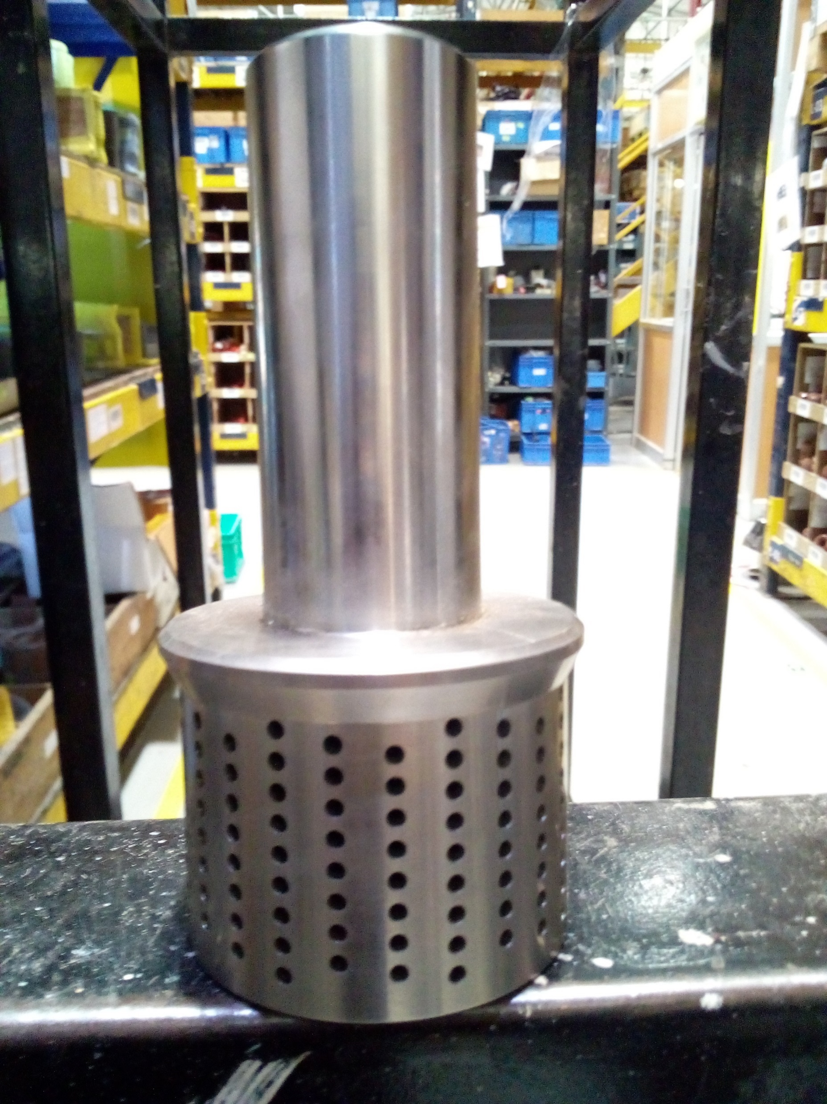

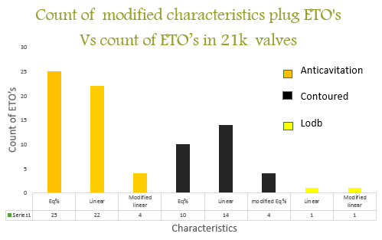
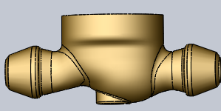

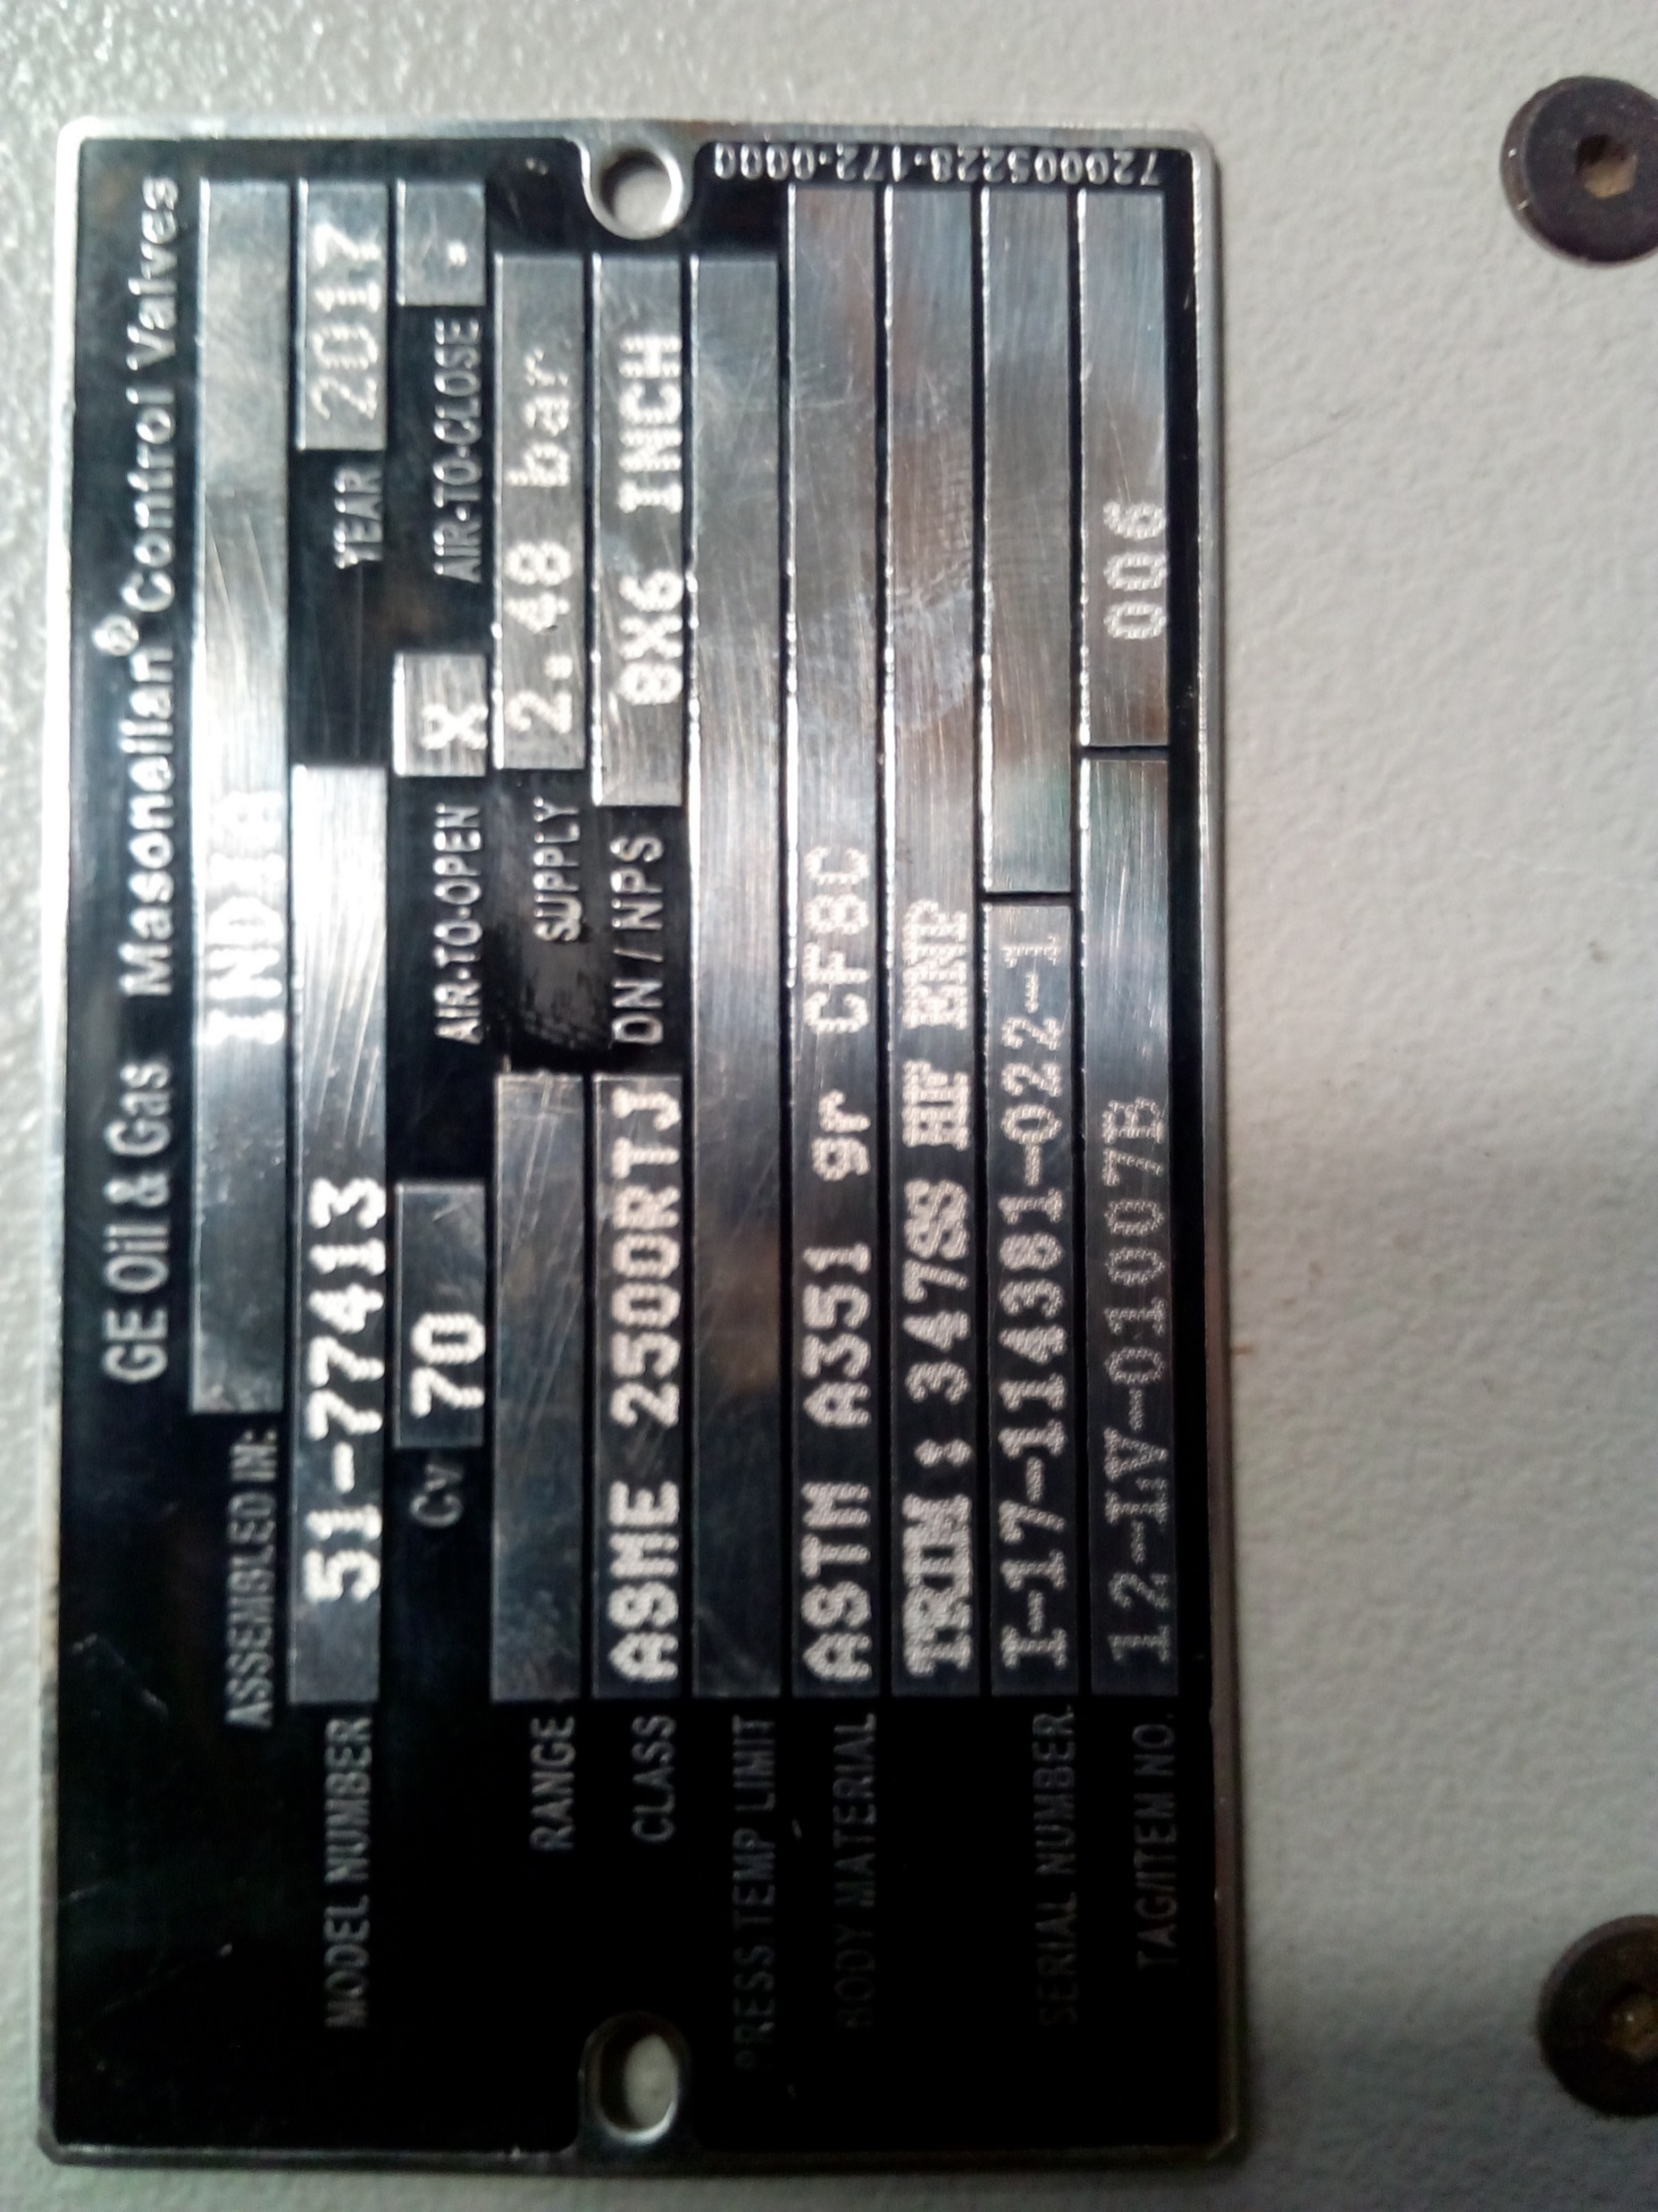


Problem
Root Causes
Solutions
Application Guidelines
Automation
Application Guidelines by widening the range.
Automating the design ETO’s
Variations in 21k and 41k valves.
Non standard Cv
End connection
Special Packing
Hole pattern automation
Benefits
Learnings
Time for designing a component is reduced through automation.
Body automation:
LD Potential savings-16K USD(approx)
plug automation:
LD potential savings- 40K USD (approx)
Industrial Ethics
Team Building
Decision making.
Body buttweld automation
Technology
Savings from automation of body ETO
Savings from automation of plug ETO
Name plate automation
Driveworks
express & Solo
VBA Macros
“I thought I was too small to make a difference, & then… I joined GE!”

